Slide 1

THE ANALYSIS OF IMPACT THAT PRICE HAS ON DEMAND WAL-MART STORES, INC.
Wal-Mart Stores, Inc., a Top 100 company
BY: TOLIY ANCHAKOV

Slide 2

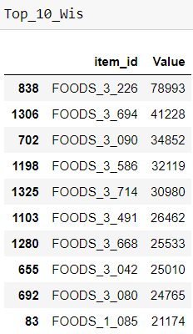
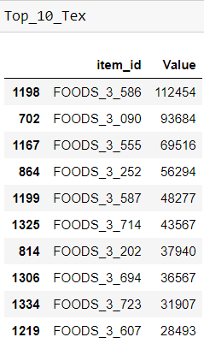
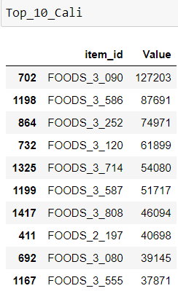
TOP 10 ITEMS BOUGHT IN EACH STATE

Slide 3

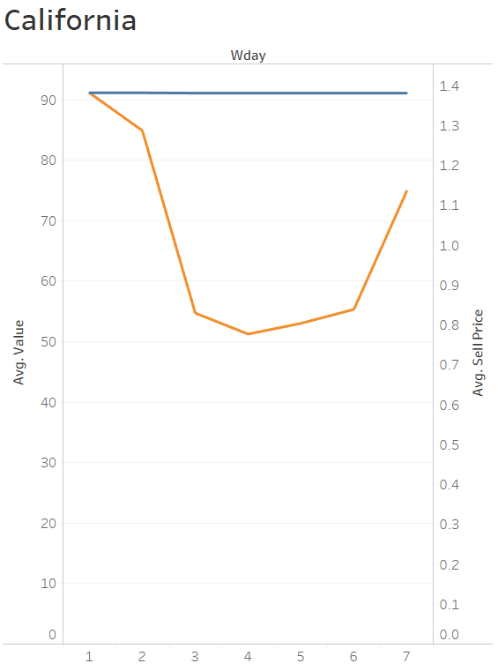
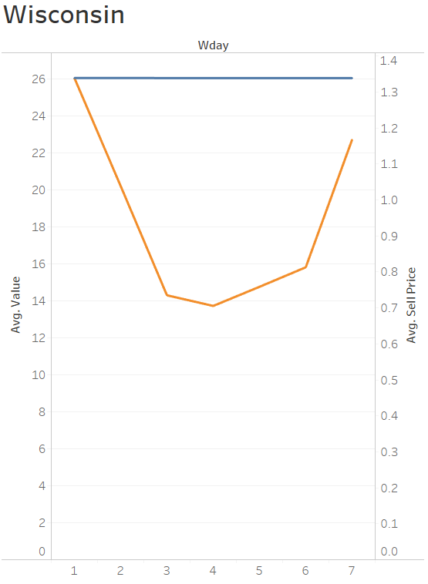
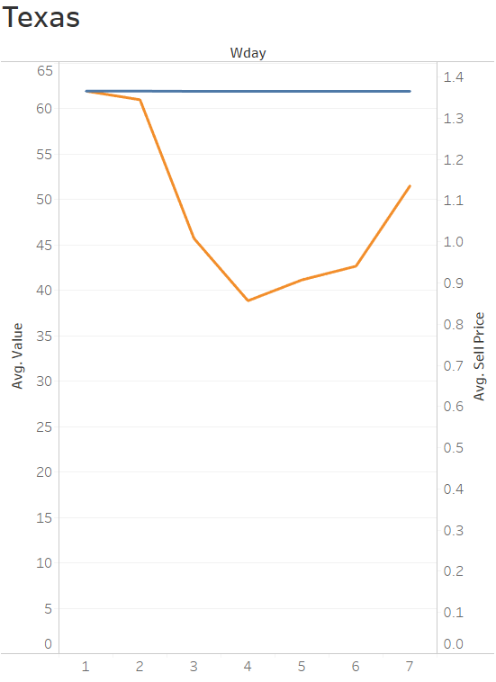
Avg. Number of Items Sold
Avg. Value
Avg. Sell Price

Slide 4
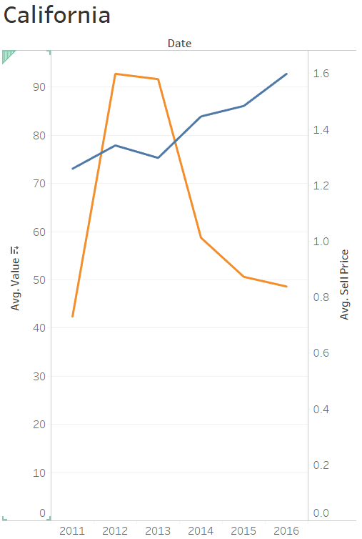
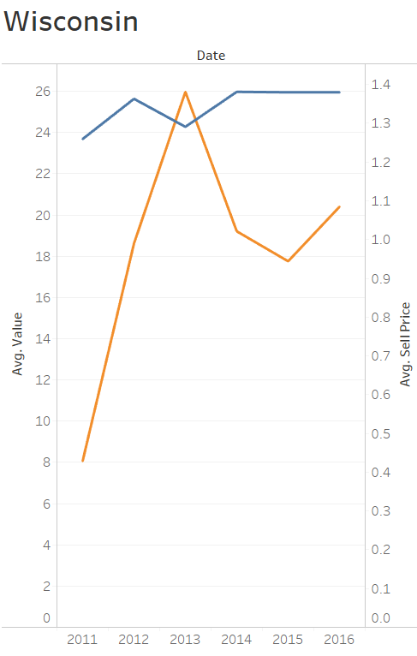
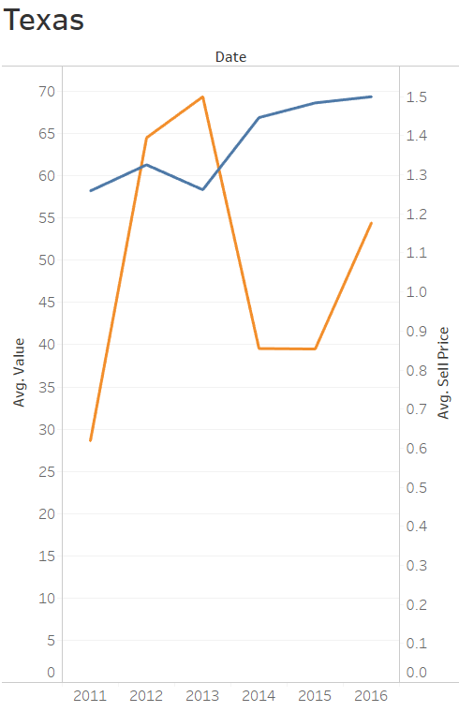
PRICE RANGE AND RATE THE ITEM WAS PURCHASED
Avg. Value
Avg. Sell Price
Correlation = -0.225563
Correlation = -0.115828
Correlation = -0.190393

Slide 5
In Conclusion
Findings
Food category dominates in items sold across all stores and states
All three stores have the same shopping pattern for item 03_090
There is no negative correlation between price and items sold which means that there are other factors that drive the demand for item 03_090
Future Analysis
Look in to all the stores from each state and seeing if there is pattern based on location that could be a contributing factor to the price and demand
See if other food items have the same pattern that they are sold, from there we can create promotions in the middle of the week help reduce volume of shoppers on the weekends.

Slide 6
Thank you for your time!

